Slide 1


From Broken Bridge to Beautiful Bridge
Presented By: OraApps 27th Dec Batch 1 BLR

Slide 2

Agenda
Introduction
Pre-Training
Power skills
Practices and Activities
Technical skills
Mandatory courses
Modules
Assessments
Fun activities
Post Training
Changes pre and post assessments
conclusion

Slide 3

Introduction
Oraapps training focuses on
Mastering Oracle ERP
Expertise in Oracle EBS
Optimizing Financial Management with Oracle
End-to-End Business Solutions
Real-World ERP Applications

Slide 4

Pre – Training
No idea about corporate culture
No domain knowledge
Poor communication skills
Poor presentation skills
Lack of confidence
Stage fear
Refusing to incorporate changes

Slide 5
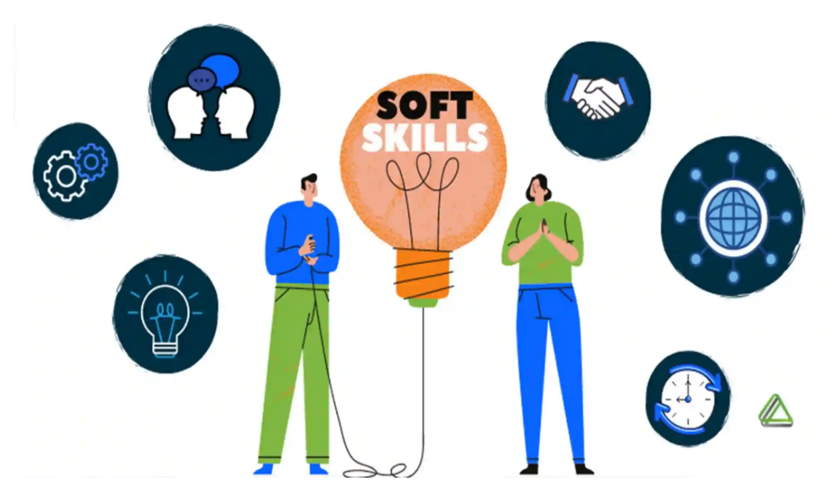
Power Skills

Slide 6

PRACTICES
ACTIVITIES
Group Presentations
Ppt presentation
Email writing
Communication skills
Speaking skills
RESUME WRITING
Interview preparation
Debate between two colleagues
Johari method – self introspection
behaviour skills training
Scenario based q/a

Slide 7
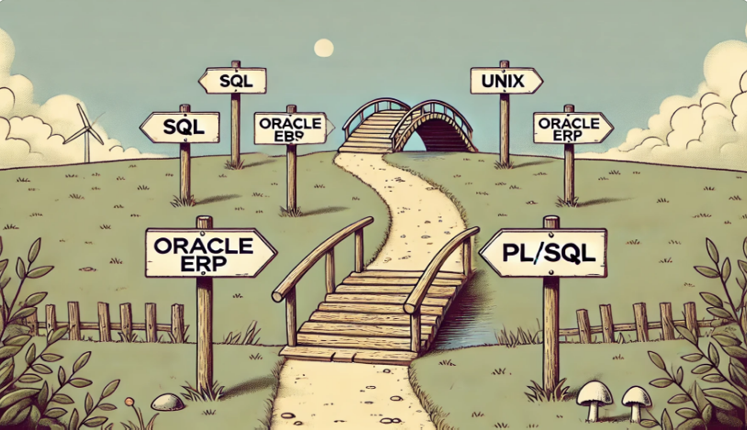
Technical Skills

Slide 8







leadership
Cyber security
Mandatory Courses
Gen ai
Industry L1
Ef solo
Agile methodology
Sustainability awareness

Slide 9
Modules
M1
M2
ORACLE SQL
UNIX
SE
PL/SQL
UNIX
ORACLE ERP
ORACLE EBS
P2P
O2C

Slide 10

Assessments
Weekly Assessments
Sprints
Core Module 1
L1

Slide 11
Fun Activities

Slide 12

Post - Training
Enhanced Problem-Solving Abilities
Proficient in Industry-Standard Tools & Techniques
Real-World Project Implementation Experience
Learnt interactions and communication with higher leads
Got hands-on on learned technical skills

Slide 13

Changes Pre and Post Assessments
Technical Knowledge
Problem Solving Skills
Corporate Standards Awareness
Communication skills
Collaboration & Teamwork
Confidence level

Slide 14

Conclusion
A bridge to success
What once seemed like gaps in our knowledge and skills have now been reinforced through training, experience, and perseverance.
This training was not just about acquiring skills—it was about building a bridge to success, ensuring we stand resilient, connected, and prepared for the journey ahead.

Slide 15


GET THE FUTURE YOU WANT

